Slide 1

ABHAY KUMAR
REGISTRATION NUMBER : (42310001)
ROLL NUMBER : (22S315008)
M.E : (CSE)

Slide 2
PROJECT TITLE:
HEART DISEASE PERDICATION USING MACHINE LEARNING ALGORITHMS:

Slide 3
Presentation Outline
System Architecture
Architecture Of Predication System
System Configuration
Machine Learning
Machine Learning Algorithms
Predication Of Disease
Data Set Details
Example Of Confusion For Matrix Accuracy (Performance Analysis)
Machine Learning Algorithms Performance Analysis Results (1) Svm 2) Knn 3) Random Forest 4) Xg-Boost 5) Ada-Boost) 6) ANN 7) DNN 8) Linear Regression 9) Logistic Regression 10) Naïve Bayes 11) Decision tree
References

Slide 4
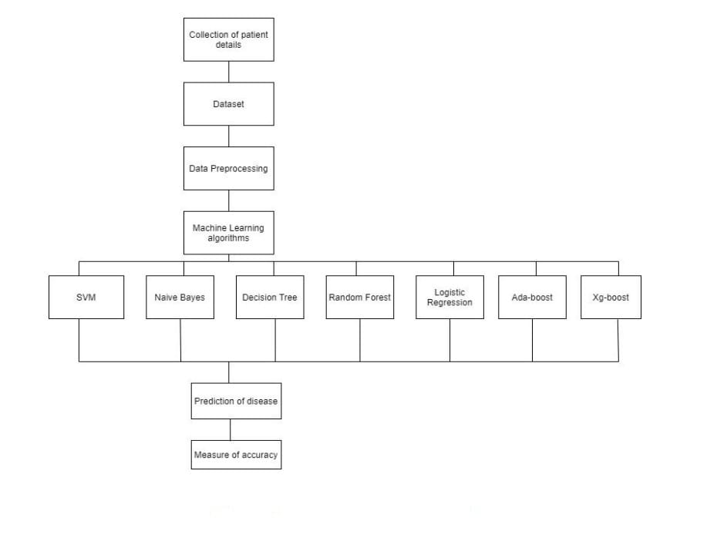
SYSTEM ARCHITECTURE:
The system architecture gives an overview of the working of the system.
The working of this system is described as follows:
Dataset collection is collecting data which contains patient details. Attributes selection process selects the useful attributes for the prediction of heart disease. After identifying the available data resources, they are further selected, cleaned, made into the desired form. Different classification techniques as stated will be applied on preprocessed data to predict the accuracy of heart disease. Accuracy measure compares the accuracy of different classifiers.

Slide 5
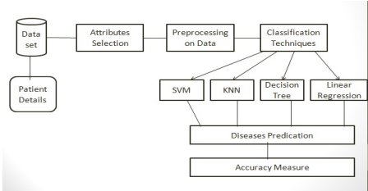
Architecture of Prediction System:

Slide 6

SYSTEM CONFIGURATION:
1 Hardware requirements:
• Processer : Any Update Processer
• Ram : Min 4GB
• Hard Disk : Min 100GB
2 Software requirements:
• Operating System : Windows family
• Technology : python 3.7
• IDE : Jupiter notebook

Slide 7
Machine Learning:
• Machine learning (ML) is a subset of artificial intelligence (AI). It uses statistical techniques to enable computers to learn and make decisions without being explicitly programmed.
• ML allows machines to automatically learn from data and past experiences to identify patterns and make predictions with minimal human intervention. For example, personal voice assistants like Siri, Alexa, and Cortana use ML-based speech recognition.
• ML is also used in social media.
• Types of machine Learning
• 1) Supervised Machine Learning.
• 2) Unsupervised Machine Learning.
• 3) Reinforcement machine Learning

Slide 8
1) Supervised MACHINE Learning :
Supervised machine learning is a type of machine learning that uses labeled data to train algorithms to classify data or predict outcomes.In supervised learning, the training data provided to the machines work as the supervisor that teaches the machines to predict the output correctly. It applies the same concept as a student learns in the supervision of the teacher. Supervised learning is a process of providing input data as well as correct output data to the machine learning model. The aim of a supervised learning algorithm is to find a mapping function to map the input variable(x) with the output variable(y).

Slide 9
2)UNSUPERVISED MACHINE LEARNING:
• Unsupervised machine learning is a machine learning technique that uses algorithms to find patterns in unlabeled data. Because Unsupervised learning cannot be directly applied to a regression or classification problem because unlike supervised learning, we have the input data but no corresponding output data. The goal of unsupervised learning is to find the underlying structure of dataset, group that data according to similarities, and represent that dataset in a compressed format.
• Unsupervised learning is helpful for finding useful insights from the data.
• Unsupervised learning is much similar to how a human learns to think by their own experiences, which makes it closer to the real AI.
• In real-world, we do not always have input data with the corresponding output so to solve such cases, we need unsupervised learning.

Slide 10

3)REINFORCEMENT MACHINE LEARNING:
• Reinforcement learning is an area of Machine Learning. It is about taking suitable action to maximize reward in a particular situation. It is employed by various software and machines to find the best possible behavior or path it should take in a specific situation.

Slide 11
MACHINE LEARNING ALGORITHMS:
• In this work, Eleven machine leaning algorithms which include
1) Random Forest
2) SVM
3) Decision Tree
4) Naïve Bayes
5) ANN
7) KNN
8) Logistic Regression
9) Linear Regression
10) Ada-boost
11) Xg-boost
These algorithms are used to unfold a prediction system which will analyze and predict whether the particular patient is pertaining to any heart disease or not with best accuracy.
6) DNN

Slide 12
1) Support Vector Machine:
• Support Vector Machine or SVM is one of the most popular Supervised Learning algorithms, which is used for Classification as well as Regression problems. However, primarily, it is used for Classification problems in Machine Learning.
• The main objective of the SVM algorithm is to find the optimal hyperplane in an N-dimensional space that can separate data points into different classes. The hyperplane tries to maximize the margin between the closest points of different classes. The optimal divider is the one that is equidistant from the boundaries of each group.
• SVMs were first introduced in the 1960s and refined in 1990. They are broadly classified into two types: simple or linear SVM and kernel or non-linear SVM
• To train and test a SVM model, the data is divided into train and test data. The data is also scaled to lie between 0 and 1

Slide 13
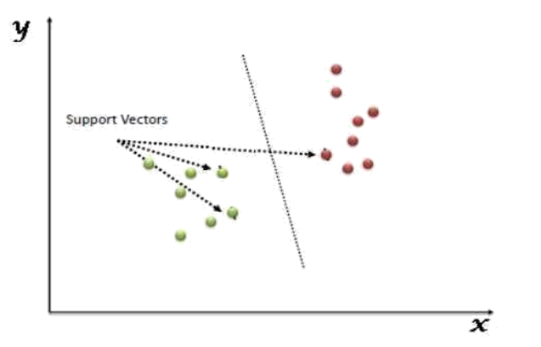
The followings are important concepts in SVM:
1) Support Vectors - Data Points that are closest to the hyperplane are called support vectors. Separating line will be defined with the help of these data points.
2) Hyperplane - As we can see in the above diagram, it is a decision plane or space which is divided between a set of objects having different classes.
3) Margin - It may be defined as the gap between two lines on the closest data points of different classes. It can be calculated as the perpendicular distance from the line to the support vectors. Large margin is considered as a good margin and small margin is considered as a bad margin.

Slide 14
Advantages And Disadvantages of support vector machines:
ADVANTAGES:
● Effective in high dimensional spaces.
● Still effective in cases where the number of dimensions is greater than the number of samples.
● Uses a subset of training points in the decision function (called support vectors), so it is also memory efficient.
DISADVANTAGES:
● If the number of features is much greater than the number of samples, avoid over-fitting in choosing Kernel functions and regularization term is crucial. SVMs do not directly provide probability estimates, these are calculated using an expensive five-fold cross-validation.

Slide 15
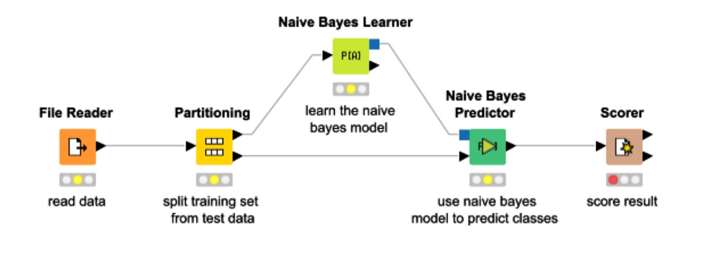
2) NAIVE BAYES ALGORITHM:
It is a machine learning technique that works on the strategy of the Bayes’ Theorem. It basically assumes that there would be no attributes dependent on each other. It is a group of algorithms that have a common principle that every feature is independent of the other. Bayes’ Theorem tells us the probability of an event that will occur when another event has already occurred. The mathematical equation is:
• Probability(a|z) = (Probability(z|a) * Probability(a)) / Probability(z)
• Where :
• Probability(a|z): Gives us the probability of a (the hypothesis) gives the data is a.
• Probability (z|a): Gives the probability of the data when the hypothesis is true.
• Probability (a): Regardless of the data, the hypothesis is said to be true.
• Probability (d): Regardless if the data, the probability of the hypothesis is given.

Slide 16
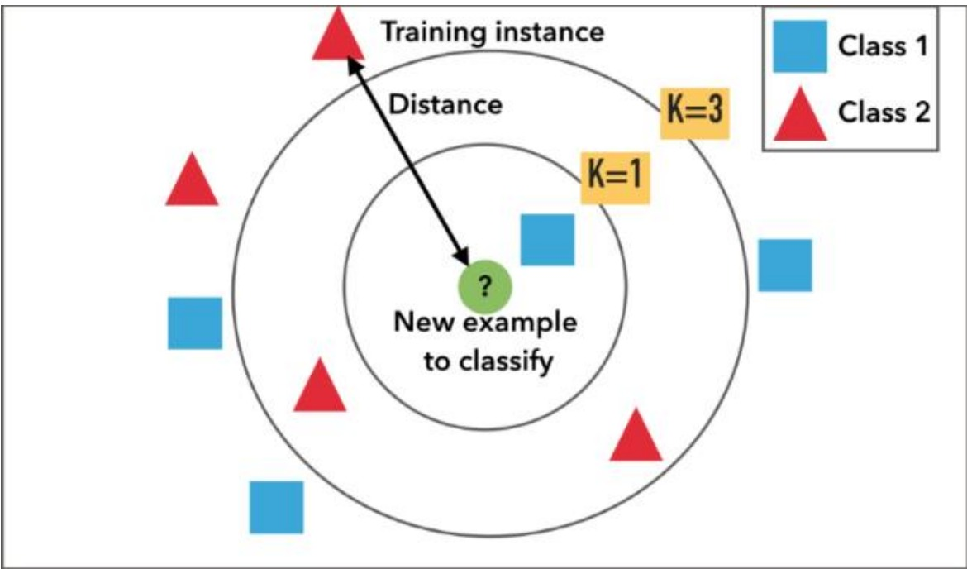
3) KNN:
• K nearest neighbors abbreviated as KNN is an algorithm that clusters data into classes and then classifies it as per their similarity measures. Classification is based on the majority of the votes to its neighbors. Data is assigned to the classes that have the nearest neighbors. As we increase the number of nearest neighbors, I.e. the value of k, the accuracy might increase. KNN is broadly used for pattern recognition and statistical prediction.
• It divides the data into clusters, based upon the distance from the nearest neighbor.

Slide 17
4) Decision Tree :
• Decision Tree is one of the supervised learning algorithms. In this the data is continuously split based on a certain parameter after which we end up getting the decision nodes and the leaves. What makes it different from the other supervised algorithms is that is can also solve the regression and classification problems easily. The main aim is to create a system that can predict the results that we desire just by learning the decision rules from the prior data, i.e., the training set.

Slide 18
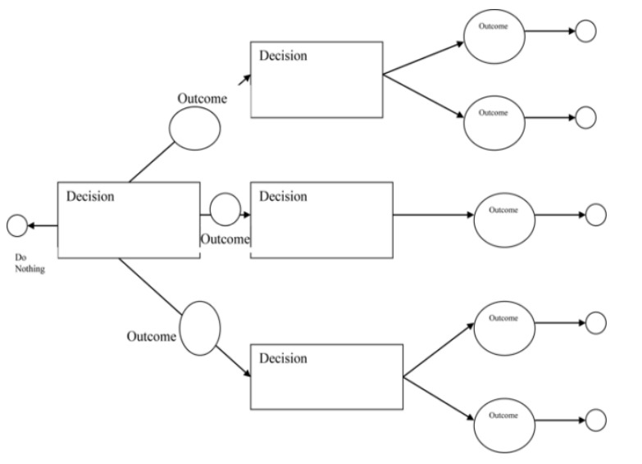
Working:
In a Decision Tree, for predicting the class of the given dataset, the algorithm starts from the root node of the tree. This algorithm compares the values of the root attribute with the record (real dataset) attribute and based on the comparison, follows the branch and jumps to the next node. For the next node, the algorithm again compares the attribute value with the other sub-nodes and moves further. It continues the process until it reaches the leaf node of the tree. The complete process can be better understood using the below algorithm:
● Step-1: Begin the tree with the root node, says S, which contains the complete dataset.
● Step-2: Find the best attribute in the dataset using Attribute Selection Measure (ASM).
● Step-3: Divide the S into subsets that contains possible values for the best attributes.
● Step-4: Generate the Decision Tree node, which contains the best attribute.
● Step-5: Recursively make new decision trees using the subsets of the dataset created in step -3. Continue this process until a stage is reached where you cannot further classify the nodes and call the final node as a leaf node.

Slide 19
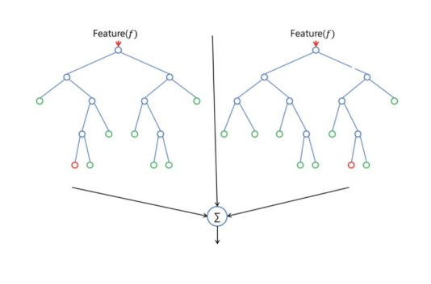
5) Random forest:
• Random Forest, just as the name suggest creates a number of random forest due to which it is also called the random decision forest. It is one of the supervised learning algorithms. It builds random forests that are basically just a group of decision trees. It is mostly trained with the bagging method as it is the most efficient. What the bagging method does is, it combines all the learning models which in turn helps us with the overall result. Just like decision trees, it can be used for both, regression and classification problems

Slide 20
Algorithm Steps:
It works in four steps:
● Select random samples from a given dataset.
● Construct a Decision Tree for each sample and get a prediction result from each Decision Tree.
● Perform a vote for each predicted result.
● Select the prediction result with the most votes as the final prediction.

Slide 21
Advantages And Disadvantages:
ADVANTAGES:
● Random Forest is capable of performing both Classification and Regression tasks.
● It is capable of handling large datasets with high dimensionality.
● It enhances the accuracy of the model and prevents the overfitting issue.
DISADVANTAGES:
Although Random Forest can be used for both classification and regression tasks, it is not more suitable for Regression tasks.

Slide 22
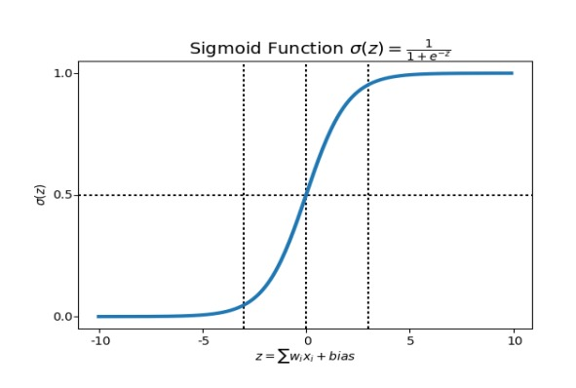
6) Logistic Regression:
• Logistic Regression is rather a predictive analysis. It is used to analyze the relation between the data among which one is a dependent variable and the other one is independent. What logistic regression does is, it rounds off all the values of the results to the closest binary value for the ease of prediction. This can sometimes cause a few errors, and not predict very precisely. In order to remove this error, multiple regression is used which helps in getting the closest to the true result. Logistic Regression uses complex cost functions such as the ‘Sigmoid function’. In machine learning sigmoid is used to predict the probabilities.

Slide 23
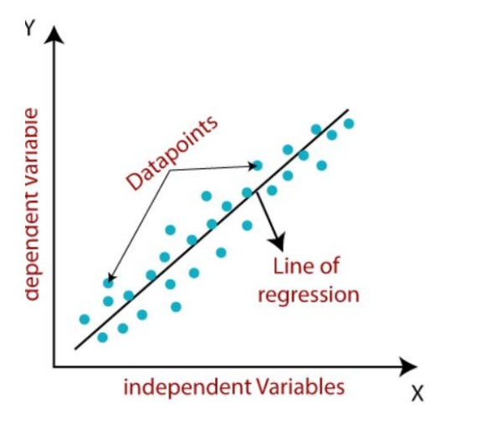
7) Linear Regression:
• Linear regression is a fundamental machine learning algorithm used for predicting numerical values based on input features. It assumes a linear relationship between the features and the target variable. The model learns the coefficients that best fit the data and can make predictions for new inputs.
• Linear regression algorithm shows a linear relationship between a dependent (y) and one or more independent (y) variables, hence called as linear regression. Since linear regression shows the linear relationship, which means it finds how the value of the dependent variable is changing according to the value of the independent variable.
• The linear regression model provides a sloped straight line representing the relationship between the variables. Consider the below image:
Y= Dependent Variable (Target Variable) X= Independent Variable (predictor Variable)

Slide 24
8) Artificial Neural Network (ANN):
An artificial neural network abbreviated as ANN is a model that works as the human brain or neural network I.e. the neurons. It is called a computational model that processes all the complex data. It isn’t given any task specific goal, but it learns from the examples or data that is given to it just like the brain. It is based on a collection of nodes called the artificial neuron. More the no. Of neurons, better the system. The neurons transmit signals from one to another making a proper connection which resembles the human neural network.
A neural network has the following 3 layers:

Slide 25
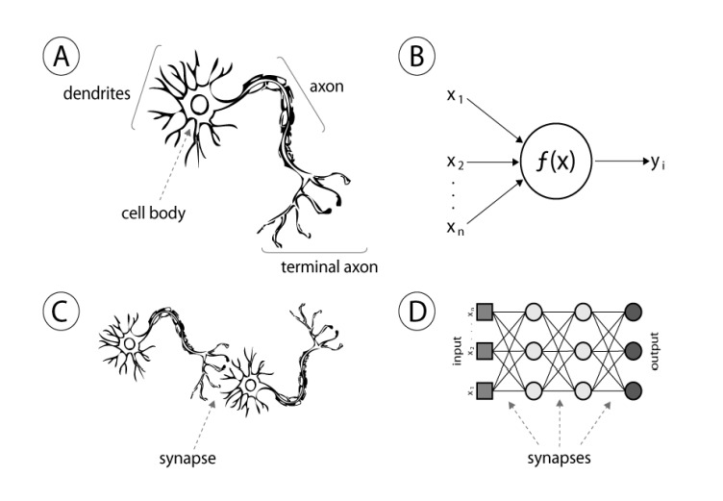
3 layers:
• Input layer – It consists of the complex raw info that we feed to the neurons.
• Hidden layer – These are the computational layers which take the input and the weight of a node from the previous layers, processes it with the activation function, and sends the output to the next layer.
• Output layer – This depends of the output of the hidden layers, and the functions taking place in there.
# The basic computational unit is the neuron. It receives inputs from the sources provided, and each input carries a weight, which is given according to the relative importance of all the other inputs. Then the function is applied to

Slide 26

9) DEEP NEURAL NETWORK:
Deep Neural Network abbreviated as DNN, is a complex neural network consisting of more than 2 layers. This algorithm uses high level mathematical models for data processing in complex manner. Deep learning is derived from a vaster family of networks of neural methods, such as CNNs. Deep learning can either be unsupervised, supervised or semi- supervised.
Deep, Convolutional and recurrent neural networks are utilized in natural language processing, computer vision, audio recognition, recognition, social network filtering, bioinformatics, machine translation, image analysis, drug design, and material inspection, where the outcomes were comparable/superior to some human professionals.

Slide 27
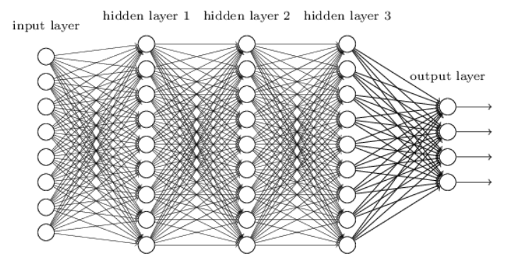
Deep Neural Networks:
• Use different layers of nonlinear units of processing for featured extraction as well as transformation. Each of the successive layers uses the previous layer’s output as the input.
• Can either be supervised, unsupervised or semi-supervised
• learn different hierarchies of representations which relate to different hierarchies of abstractions.
• It consists of an input layer, an output layer and between many variable hidden layers.
• Output of one layer goes as the input to other. The activation function used in our module is the ReLU between hidden layers and Softmax at the output layer which takes 0 or 1 .

Slide 28
10) ADABOOST ALGORITHM:
• Adaboost was the first really successful boosting algorithm developed for the purpose of binary classification. Adaboost is short for Adaptive Boosting and is a very popular boosting technique which combines multiple “weak classifiers” into a single “strong classifier”
• ALGORITHM:
• 1. Initially, Adaboost selects a training subset randomly.
• 2. It iteratively trains the Adaboost machine learning model by selecting the training set based on the accurate prediction of the last training.
• 3. It assigns the higher weight to wrong classified observations so that in the next iteration these observations will get the high probability for classification.
• 4. Also, it assigns the weight to the trained classifier in each iteration according to the accuracy of the classifier. The more accurate classifier will get high weight.
• 5. This process iterates until the complete training data fits without any error or until reached to the specified maximum number of estimators.
• 6. To classify, perform a "vote" across all of the learning algorithms you built

Slide 29
Advantages And Disadvantages:
Advantages:
• It's easy to implement
• It can be used with any dataset
• It's less prone to overfitting than other algorithms
• It can improve the accuracy of weak classifiers
• It can be used with many base classifiers
• It's easier to use than other algorithms
• It can be used to classify text and images
• Disadvantages:
• AdaBoost uses a progressively learning boosting technique. Hence high-quality data is needed in examples of AdaBoost vs Random Forest. It is also very sensitive to outliers and noise in data requiring the elimination of these factors before using the data.

Slide 30
11) XGBOOST ALGORITHM:
• XGBoost is a robust machine-learning algorithm that can help you understand your data and make better decisions. XGBoost is an implementation of gradient-boosting decision trees.
• XG-boost is an implementation of Gradient Boosted decision trees. It is a type of Software library that was designed basically to improve speed and model performance. In this algorithm, decision trees are created in sequential form. Weights play an important role in XG-boost. Weights are assigned to all the independent variables which are then fed into the decision tree which predicts results. Weight of variables predicted wrong by the tree is increased and these the variables are then fed to the second decision tree. These individual classifiers/predictors then assemble to give a strong and more precise model. It can work on regression, classification, ranking, and user-defined predict.

Slide 31
1) Regularization:
• Regularization: XGBoost incorporates regularization techniques to prevent overfitting. It includes both L1 and L2 regularization terms in its objective function, which helps in controlling the complexity of the model and reducing variance.
• gamma: The minimum loss reduction allowed for a split to occur. The optimal value of gamma depends on the data set and other parameter values.
• alpha: L1 regularization on leaf weights. Larger values mean more regularization.
• lambda: L2 regularization. This term is a constant that is added to the second derivative (Hessian) of the loss function during gain and weight (prediction) calculations.
• The regularization term (Ω) is a combination of L1 and L2 regularization terms. It is defined as:
• Ω(F) = λ * Ω1(F) + 0.5 * γ * Ω2(F)
• WHERE:
• Ω1(F) is the L1 norm of the leaf weights
• Ω2(F) is the L2 norm of the leaf weights
• Regularization parameters usually impact tree structure as well as weight values

Slide 32
2) Parallel processing:
• Parallelization – The process of sequential tree building is done using the parallelized implementation in the XGBoost algorithm. This is made possible due to the outer and inner loops that are interchangeable. The outer loop lists the leaf nodes of a tree, while the inner loop will calculate the features.
• : XG-boost utilizes the power of parallel processing and that is why it is much faster than GBM. It uses multiple CPU cores to execute the model. While using Scikit Learn libarary, nthread hyper-parameter is used for parallel processing. nthread represents number of CPU cores to be used. If you want to use all the available cores, don't mention any value for nthread and the algorithm will detect automatically.

Slide 33
3) Handling missing values:
• XG-boost has an in-built capability to handle missing values. When XG-boost encounters a missing value at a node, it tries both the left and right hand split and learns the way leading to higher loss for each node. It then does the same when working on the testing data.
4) Cross Validation: XG-boost allows user to run a cross-validation at each iteration of the boosting process and thus it is easy to get the exact optimum number of boosting iterations in a single run. This is unlike GBM where we have to run a grid-search and only a limited values can be tested.

Slide 34
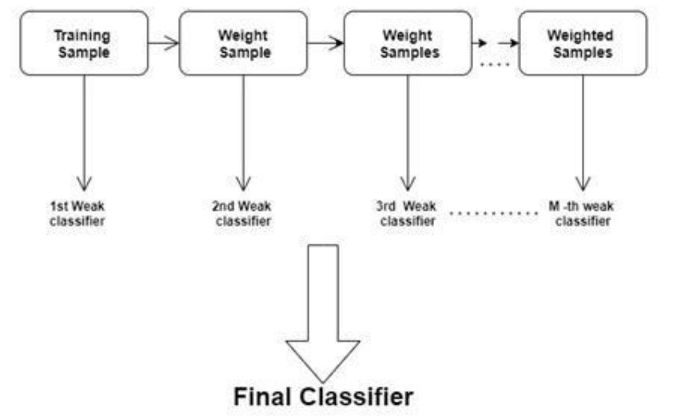
5) Effective Tree Pruning:
• Tree Pruning: XGBoost uses max_depth parameter as specified the stopping criteria for the splitting of the branch, and starts pruning trees backward. This depth-first approach improves computational performance significantly.
• A GBM would stop splitting a node when it encounters a negative loss in the split. Thus it is more of a greedy algorithm. XG-boost on the other hand make splits upto the max_depth specified and then start pruning the tree backwards and remove splits beyond which there is no positive gain.

Slide 35
Predication of Disease:
• Disease Prediction is a Machine Learning based system which primarily works according to the symptoms given by a user. The disease is predicted using algorithms and comparison of the datasets with the symptoms provided by the user.
• Machine learning (ML) can predict diseases by using algorithms to compare a user's symptoms with datasets. The system takes the user's symptoms as input and outputs the probability of the disease.
• Some machine learning algorithms used for disease prediction include:
• Naïve Bayes classifier: A supervised machine learning algorithm that calculates the probability of the disease
• Random forest classifier: Used to predict disease likelihood
• Support vector machine: A supervised learning algorithm
• Logistic regression: A supervised learning algorithm
• Artificial neural network: A supervised learning algorithm

Slide 36
DATA SET DETAILS :
For eg: Our system here, uses a dataset to predict the occurrence of heart diseases by dividing the dataset into test data and training data. 70% data is used for training and the rest 30% is used for testing. Now, the input used in our case is the attributes we have used that correspond to factors that result in heart diseases. The output would be a binary digit indicating whether a person is susceptible to heart diseases or not. The algorithms used in the system for prediction, are learning algorithms which will always change over periods of time based on various input factors . Therefore, the results might change when we learn even more about the data fed as input.
• Heart Disease UCI :https://github.com/Abhayku18113211/Heart-Disease.

Slide 37
Data set used:
For our system, we have taken dataset that was publicly available on Kaggle for predicting the heart diseases. The parameters used as input for data analysis using Machine learning algorithm are as follows:
1. age: which is taken in years
2. sex: 1 for male, 0 for female
3. cp: short for chest pain
4. trestbps: blood pressure taken when the body is resting
5. chol: level of cholesterol
6. fasting blood sugar: (1 for true; 0 for false)
7. resting electrocardiographic results Value 0: normal Value 1: having the ST-T wave which is not normal Value 2: shows the probability of having left ventricular hypertrophy
8. thalach: the max level of heartbeats achieved by heart
9. exercise induced angina: 1 for yes, 0 for no
10. oldpeak: the depression by exercise compared to the one at rest
11. slope: peak of the ST segment during exercise
Value 1: no slope
Value 2: straight line
Value 3: down sloping
12. ca: major vessels (0-3) colored by fluoroscopy
13. thal: 3= perfect; 6=permanently defected; 7=defect can be altered 14. num: heart disease diagnoses

Slide 38
Measure of Accuracy (Performance Analysis):
• In this project, various machine learning algorithms like SVM, Naive Bayes, Decision Tree, Random Forest, Logistic Regression, Adaboost Xgboost are used to predict heart disease. Heart Disease UCI dataset, has a total of 76 attributes, out of those only 14 attributes are considered for the prediction of heart disease. Various attributes of the patient like gender, chest pain type, fasting blood pressure, serum cholesterol, exang etc are considered for this project. The accuracy for individual algorithms has to measure and whichever algorithm is giving the best accuracy that is considered for the heart disease prediction. For evaluating the experiment, various evaluation metrics like accuracy, confusion matrix, precision, recall, and f1-score are considered.
Accuracy- Accuracy is the ratio of the number of correct predictions to the total number of inputs in the dataset.
• 1) The accuracy rate of each algorithm has been measured and selects the algorithm with the highest accuracy. The accuracy rate is a correct prediction ratio to the total number of given datasets. It is expressed as:
• Accuracy = (TP + TN) /(TP+FP+FN+TN)
• Where:
• TP: True Positive
• TN: True Negative
• FP: False Positive
• FN: False Negative

Slide 39
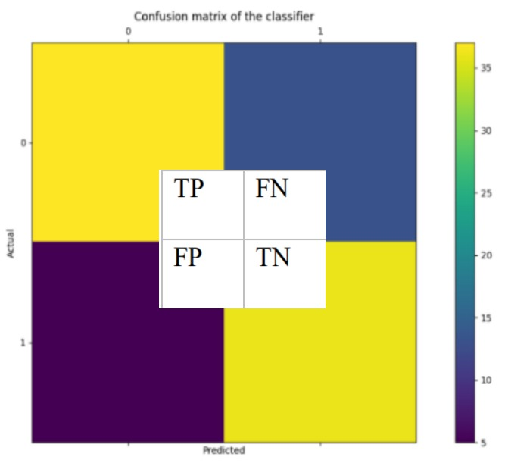
1)Confusion Matrix:
• It gives us a matrix as output and gives the total performance of the S system.
• It is a binary classifier. A confusion matrix can be of any size depending upon the different number of parameters inputted (labels in our case).
• Where:
• TP: True positive
• FP: False Positive
• FN: False Negative
• TN: True Negative
• The numerical value of TP, FP, TN, FN defines as:
• TP= occur when the model accurately predicts a positive data point.
• TN= occur when the model accurately predicts a negative data point.
FP= occur when the model predicts a positive data point incorrectly.
FN= occur when the model mispredicts a negative data point.

Slide 40
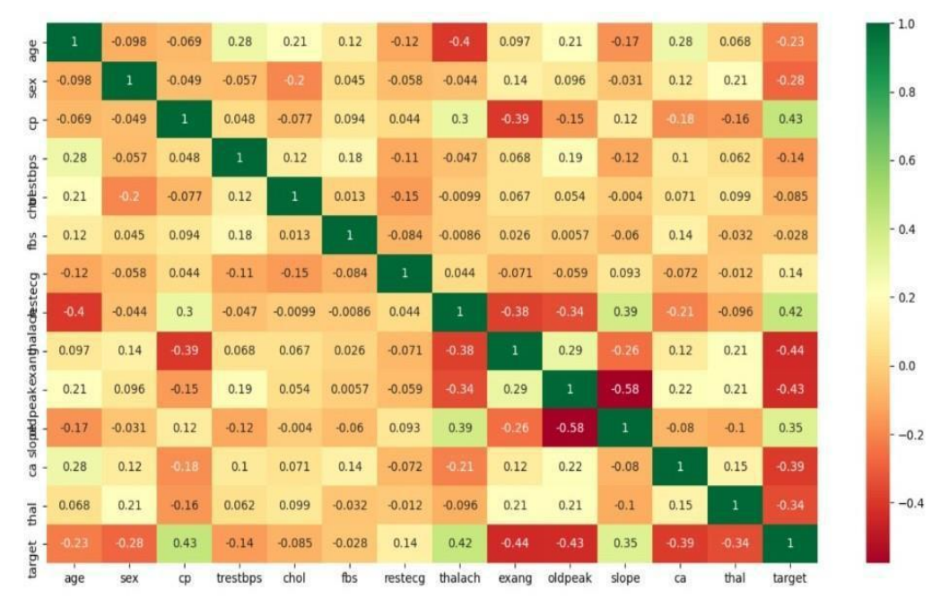
2) Correlation Matrix:
The correlation matrix in machine learning is used for feature selection. It represents dependency between various attributes. Selection of attributes: Attribute or Feature selection includes the selection of appropriate attributes for the prediction system. This is used to increase the efficiency of the system. Various attributes of the patient like gender, chest pain type, fasting blood pressure, serum cholesterol, exang etc are selected for the prediction. The Correlation matrix is used for attribute selection for this model.

Slide 41
3) Precision:
• - It is the ratio of correct positive results to the total number of positive results predicted by the system.
• 𝑃𝑟𝑒𝑐𝑖𝑠𝑖𝑜𝑛 = 𝑇𝑃/(𝑇𝑃 + 𝐹𝑃)
• It is expressed as:
• 4) Recall-
It is the ratio of correct positive results to the total number of positive results predicted by the system.
• 𝑅𝑒𝑐𝑎𝑙𝑙 = 𝑇𝑃/(𝑇𝑃 + 𝐹𝑁)
• 5) F1 score-:
This metric takes into recall and precision and is calculated as below
It is the harmonic mean of Precision and Recall. It measures the test accuracy. The range of this metric is 0 to 1. It is expressed as:
𝐹1 𝑠𝑐𝑜𝑟𝑒 = 2 ∗ (𝑃𝑟𝑒𝑐𝑖𝑠𝑖𝑜𝑛 ∗ 𝑅𝑒𝑐𝑎𝑙𝑙)/(𝑃𝑟𝑒𝑐𝑖𝑠𝑖𝑜𝑛 + 𝑅𝑒𝑐𝑎𝑙𝑙)
6) MCC:
Matthews Correlation Coefficient considers all four divisions of the confusion matrix when calculated. MCC lies within the range -1 to +1 where a model with a positive score is considered to be perfect whereas the negative score is poor. This makes this metric really useful as it is easy to interpret
𝑀𝐶𝐶 = (𝑇𝑃 ∗ 𝑇𝑁 − 𝐹𝑃 ∗ 𝐹𝑁)/√((𝑇𝑃 + 𝐹𝑃) ∗ (𝑇𝑃 + 𝐹𝑁) ∗ (𝑇𝑁 + 𝐹𝑃) ∗ (𝑇𝑁 + 𝐹𝑁))

Slide 42
Example Of Confusion Matrix For Measure Accuracy (Performance Analysis):
A 2X2 Confusion matrix is shown below for the image recognition having a Heart Patient image or Not Heart Patient image.
INDEX | 1 | 2 | 3 | 4 | 5 | 6 | 7 | 8 | 9 | 10
Actual | Patient | Patient | Patient | Not Patient | Patient | Not Patient | Patient | Patient | Not Patient | Not Patient
Predicted | Patient | Not Patient | Patient | Not Patient | Patient | Patient | Patient | Patient | Not Patient | Not Patient
Result | TP | FN | TP | TN | TP | FP | TP | TP | TN | TN
Actual Patient Counts = 6
Actual Not Patient Counts = 4
True Positive Counts = 5
False Positive Counts = 1
True Negative Counts = 3
False Negative Counts = 1

Slide 43
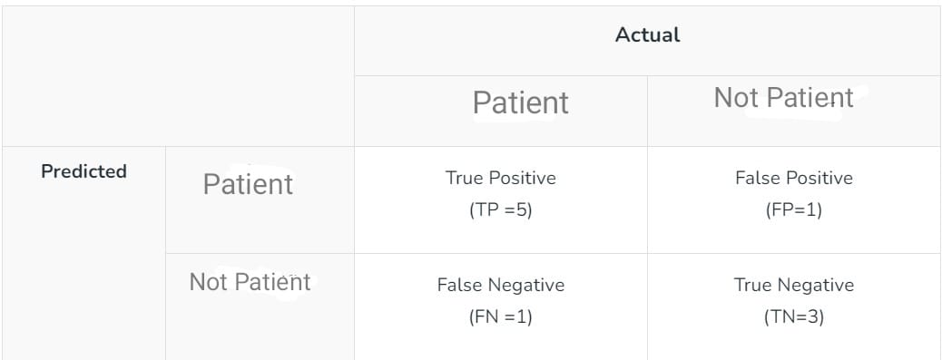
Metrics based on Confusion Matrix Data:
2. Precision
2) Precision : is a measure of how accurate a model’s positive predictions are. It is defined as the ratio of true positive predictions to the total number of positive predictions made by the model.
𝑇𝑃/(𝑇𝑃 + 𝐹𝑃)
For the above case: Precision = 5/(5+1) =5/6 = 0.8333
1. Accuracy
Accuracy is used to measure the performance of the model. It is the ratio of Total correct instances to the total instances.
Accuracy = (TP + TN) /(TP+FP+FN+TN)
For the above case:
Accuracy = (5+3)/(5+3+1+1) = 8/10 = 0.8

Slide 44
3. Recall
It is the ratio of correct positive results to the total number of positive results predicted by the system.
• 𝑅𝑒𝑐𝑎𝑙𝑙 = 𝑇𝑃/(𝑇𝑃 + 𝐹𝑁)
For the above case:
Recall = 5/(5+1) =5/6 = 0.8333
4. F1-Score :
F1 – Score is used to evaluate the overall performance of a classification model. It is the harmonic mean of precision and recall,
𝐹1 𝑠𝑐𝑜𝑟𝑒 = 2 ∗ (𝑃𝑟𝑒𝑐𝑖𝑠𝑖𝑜𝑛 ∗ 𝑅𝑒𝑐𝑎𝑙𝑙)/(𝑃𝑟𝑒𝑐𝑖𝑠𝑖𝑜𝑛 + 𝑅𝑒𝑐𝑎𝑙𝑙)
For the above case:
F1-Score: = (2* 0.8333* 0.8333)/( 0.8333+ 0.8333) = 0.8333

Slide 45
REFERENCES:
[1] Animesh Hazra, Arkomita Mukherjee, Amit Gupta, Asmita Mukherjee, “Heart Disease Diagnosis and Prediction Using Machine Learning and Data Mining Techniques: A Review”, Research Gate Publications, July 2017, pp.2137-2159.
[2] V. Krishnaiah, G. Narsimha, N. Subhash Chandra,“Heart Disease Prediction System using Data Mining Techniques and Intelligent Fuzzy Approach: A Review”,International Journal of Computer Applications,February 2016.
[3] Guizhou Hu, Martin M. Root,“Building Prediction Models for Coronary Heart Disease by Synthesizing Multiple Longitudinal Research Findings”, European Science of Cardiology, 10 May 2005.
[4] T.Mythili, Dev Mukherji, Nikita Padaila and Abhiram Naidu, “A Heart Disease Prediction Model using SVM- Decision Trees- Logistic Regression (SDL)”,International Journal of Computer Applications, vol.68,16 April 2013
[5] Nimai Chand Das Adhikari, Arpana Alka, and rajat Garg, “HPPS: Heart Problem Prediction System using Machine Learning”.
[6] K. Polaraju, D. Durga Prasad, “Prediction of Heart Disease using Multiple Linear Regression Model”,International Journal of Engineering Development and Research Development, ISSN:2321-9939, 2017.
[7] Marjia Sultana, Afrin Haider, “Heart Disease Prediction using WEKA tool and 10-Fold cross-validation”, The Institute of Electrical and Electronics Engineers, March 2017.
[8] Dr.S.Seema Shedole, Kumari Deepika, “Predictive analytics to prevent and control chronic disease”, https://www.researchgate.net/punlication/316530782,January 2016.
[9] Ashok kumar Dwivedi, “Evaluate the performance of different machine learning techniques for prediction of heart disease using ten-fold cross-validation”, Springer, 17 September 2016.
[10] Megha Shahi, R. Kaur Gurm, “Heart Disease Prediction System using Data Mining Techniques”, Orient J. Computer Science Technology, vol.6 2017, pp.457-466
[11] Purushottam, Prof. (Dr.) Kanak Saxena, Richa Sharma, “Efficient Heart Disease Prediction System”, 2016, pp.962-969

